Slide 1
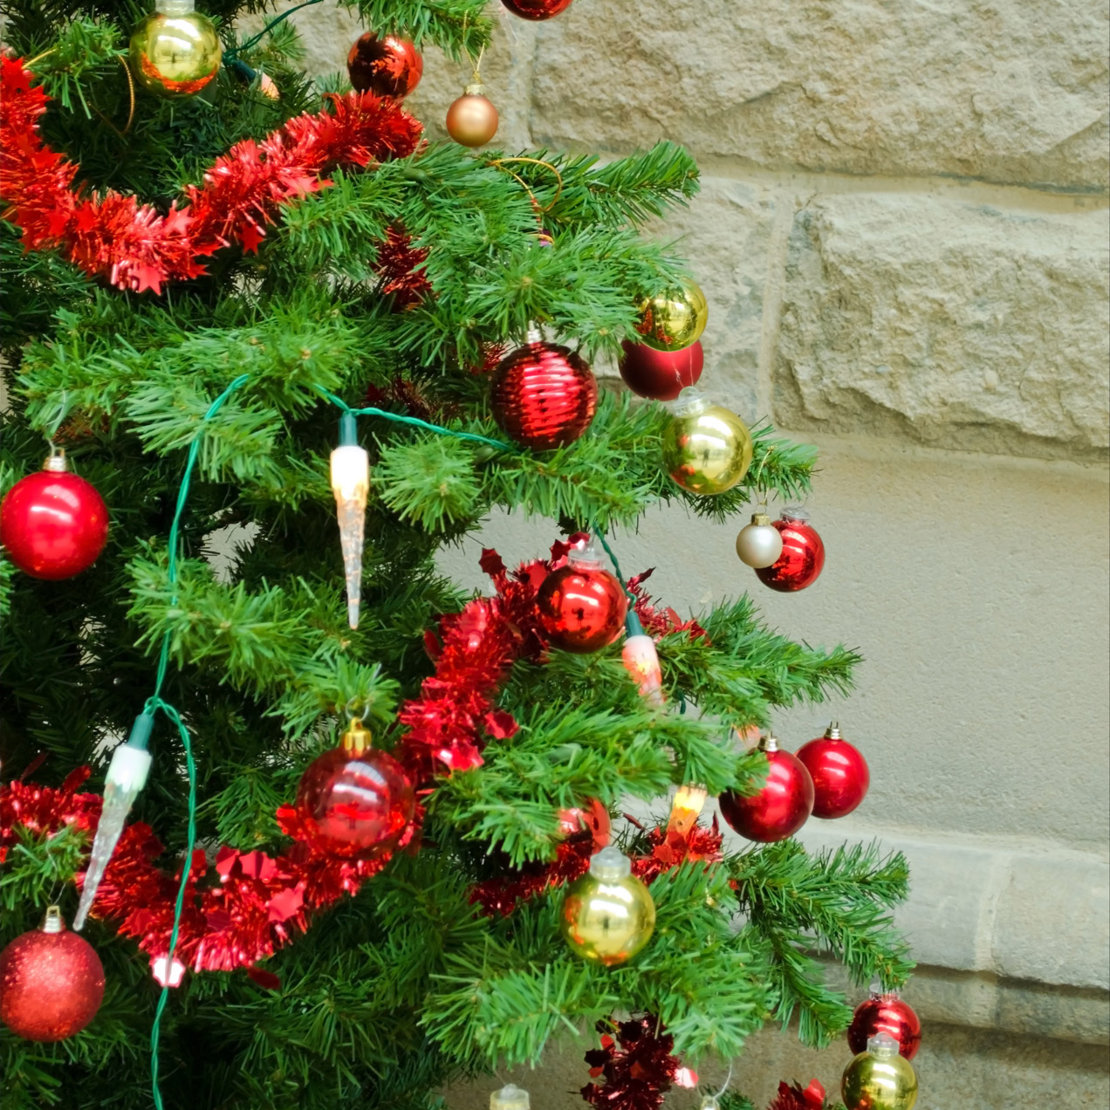
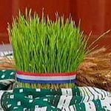
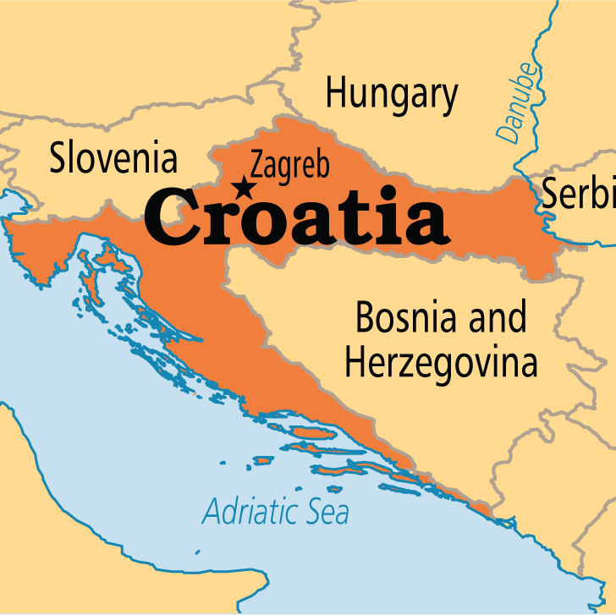
Christmas in Croatia
Baranja region
Baranja
December, 2023. Željka Krizmanić
Translation, Klara Bošnjaković

Slide 2
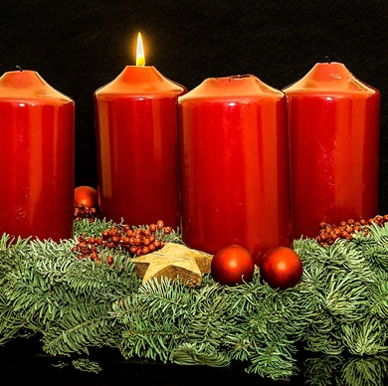
CHRISTMAS EVE CUSTOMS
ADVENT
In anticipation of Christmas, four candles are lit during the four weeks of Advent. The first candle is lit on December 3rd.

Slide 3
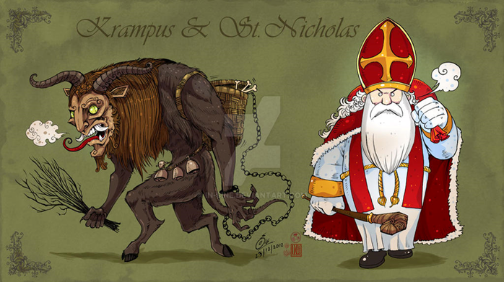
Saint Nicholas, December 6th.
On St. Barbara's Day, December 4th, wheat is sown, symbolizing new life and prosperity.
The wheat is placed on the holiday table and near the Nativity scene.
Children place a clean boot by the window. Saint Nicholas brings gifts to well-behaved children on the evening of December 6th, accompanied by Krampus, who leaves a switch if the children have been naughty.
Saint Lucy, December 13th
.
For Saint Lucy, children make scary figures out of pumpkins. A candle is placed inside the pumpkin.

Slide 4
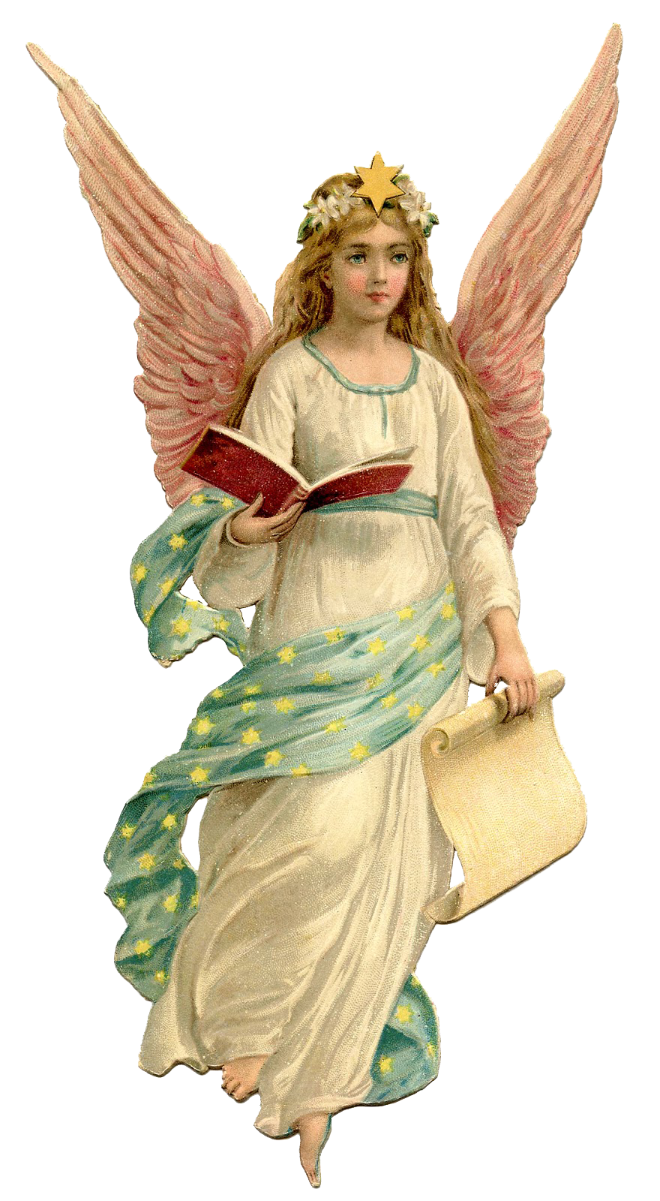
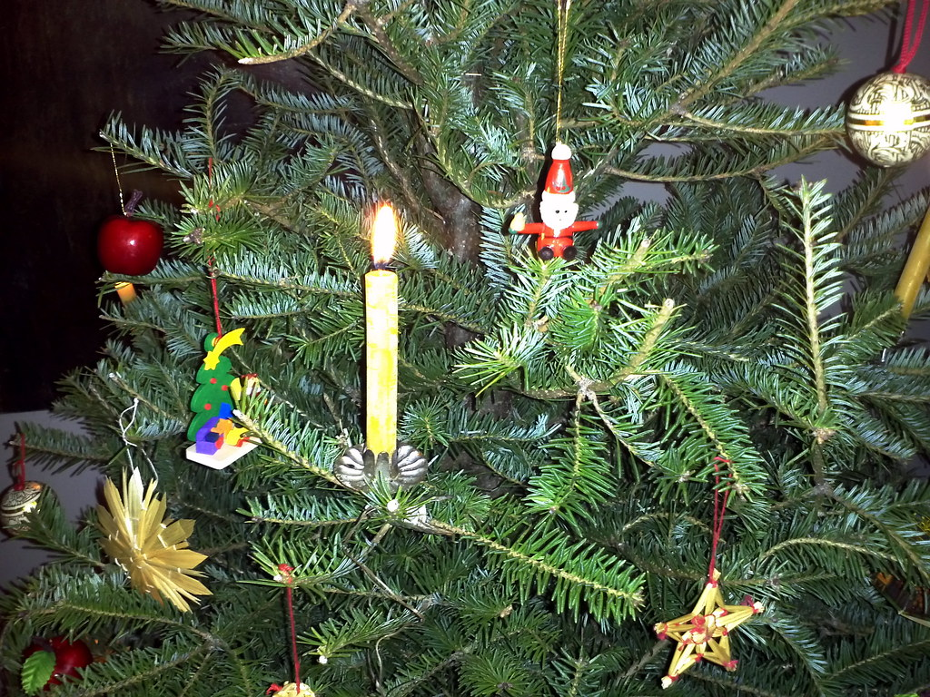
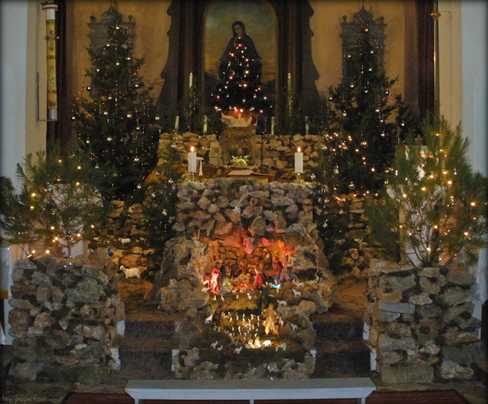
On Christmas Eve, the tree is decorated. In the past, it was said that angels bring gifts to children. The tree was adorned with candies.
Midnight mass
The family attends the midnight Mass. Nativity scenes are displayed in the church.

Slide 5
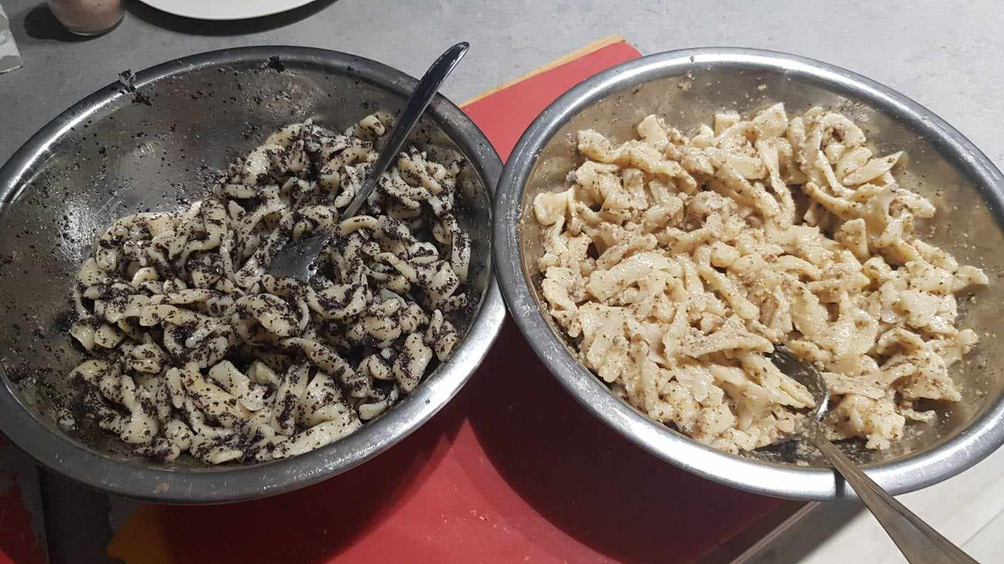
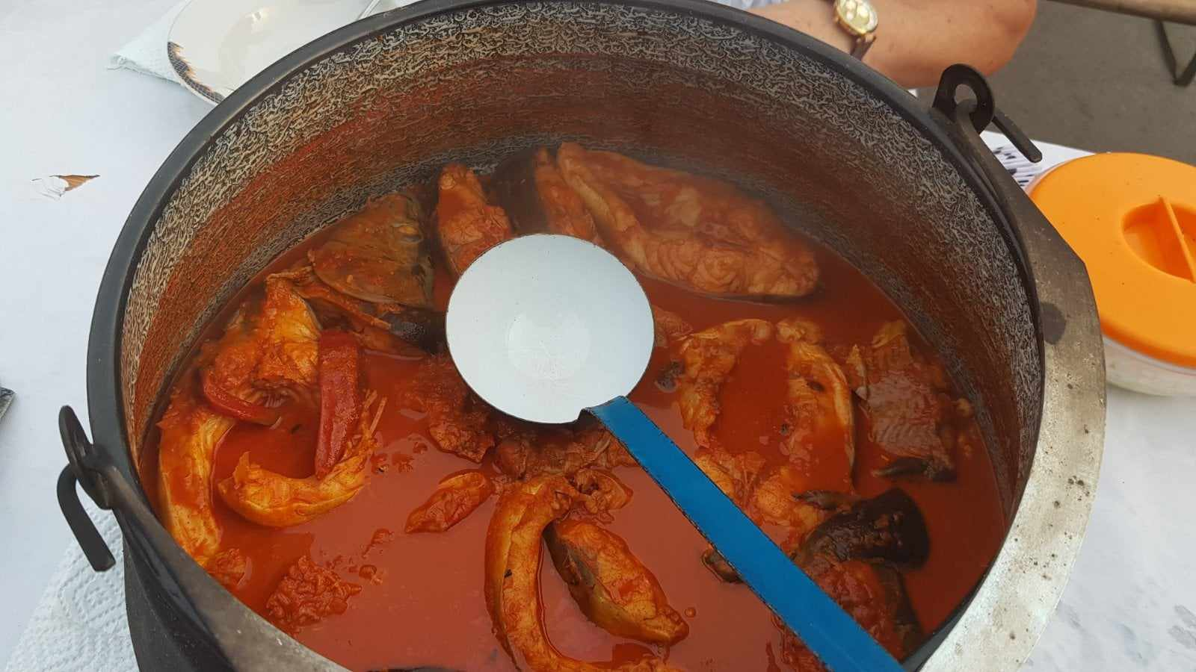
FOOD
On Christmas Eve, fasting food is consumed, such as fish stew and pasta with poppy seeds and walnuts.

Slide 6
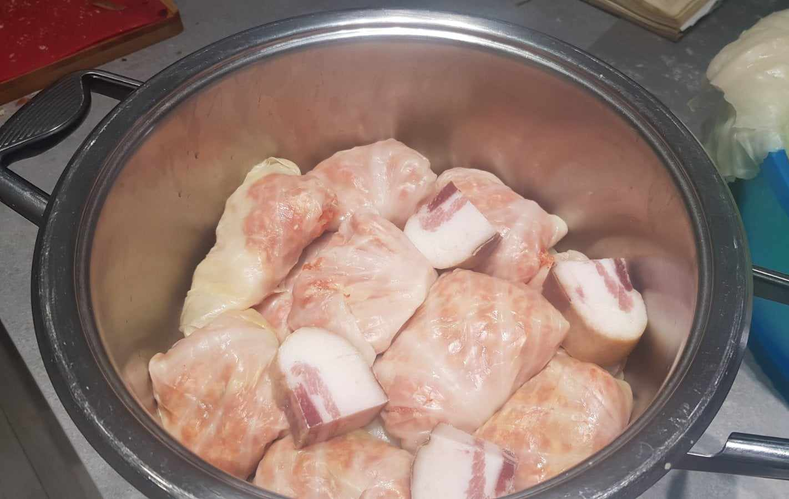
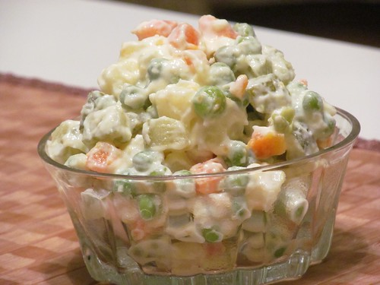
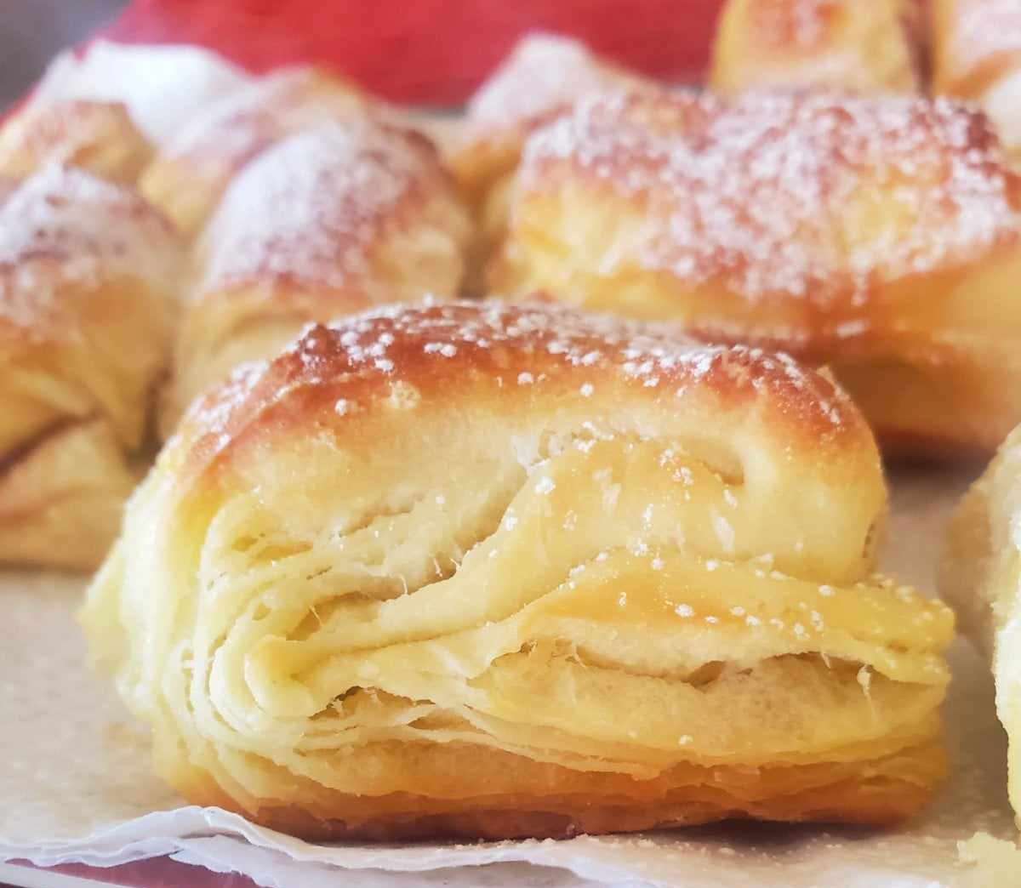
On Christmas day, the family eats together.
There are various cakes, meat and vegetables on the table.
cabbage rolls
peas, carrots, cucumbers,
mayonnaise, eggs
turkey

Slide 7
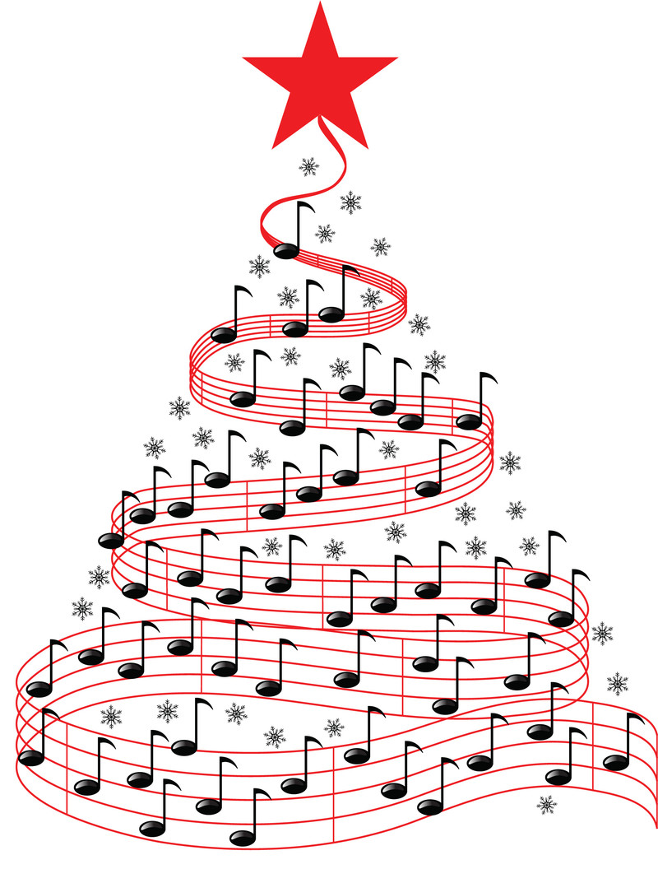
Traditional Christmas carols
U to vrijeme godišta
https://youtu.be/1DDsd9iqLnI?si=LaM7la28KZTysXVg
Veselje ti navješćujem
https://youtu.be/W2YFUWvWzno?si=5XBqCRtuGwhSuD4i
Svim na zemlji
https://youtu.be/p7nwUL18zpk?si=KQXIHJDHaQ-5Mpwn
O pastiri čudo novo
https://youtu.be/DLKq_ydRw-g?si=gN_1XejmG6YAx4jc

Slide 8
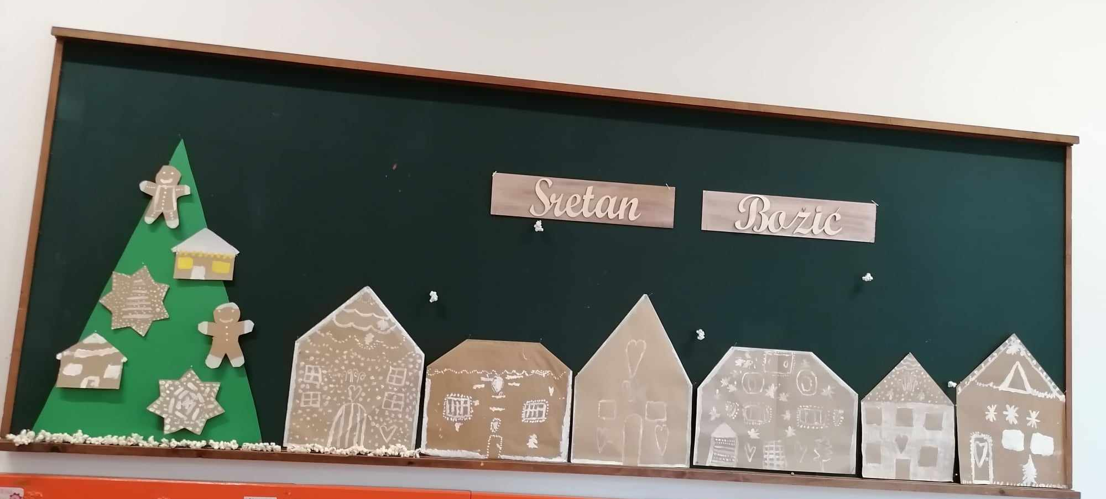
Christmas in our school in Kozarac

Slide 9
Čestit Božić!
Merry Christmas!
STEAM group, Kozarac

Slide 10
Literature
Naše kolo veliko, Goran Knežević
Creative commons

